Slide 1



Big Data Project Airline Passenger Satisfaction
Cairo University
Faculty of Engineering
Prepared by Team VII
Supervised by Eng. Omar Samir

Slide 2
Agenda
0
1
2
Motivation & Pipeline
Data Preparation
EDA
3
4
Apriori Model
Naive Bayes
5
6
SVM & RF Model
Back to Business

Slide 3

Motivation
Airline industry is undeniably massive
$800B annually
6M daily travelers
Largely controlled by customer satisfaction
Key determinants of satisfaction still remain “unknown”
Main ingredients of a perfect airline firm

Slide 4
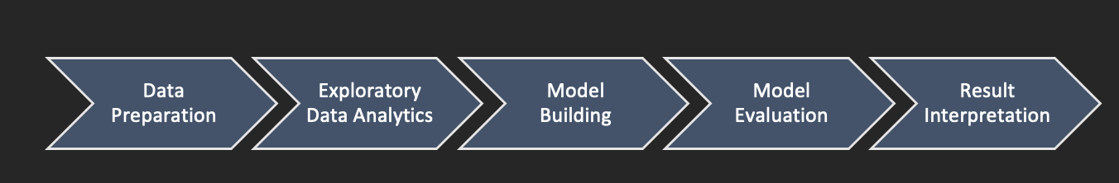
Pipeline

Slide 5
Data Preparation
Done through PySpark
Reading a specific split of the data (training or validation)
Reading specific column types from the data (numerical, ordinal or categorical)
Frequency Encoding
Dropping missing values
Imputing numerical outliers
Later, label encoder and bucketizing

Slide 6
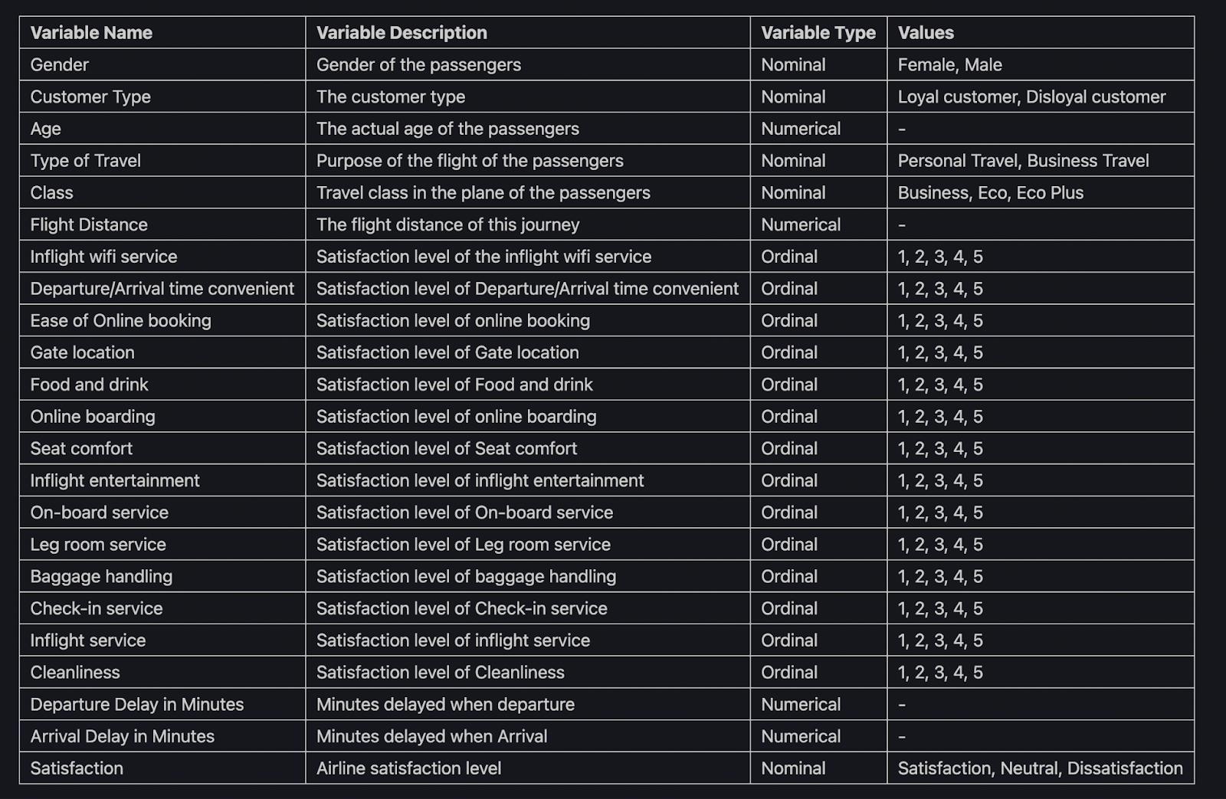
EDA

Slide 7
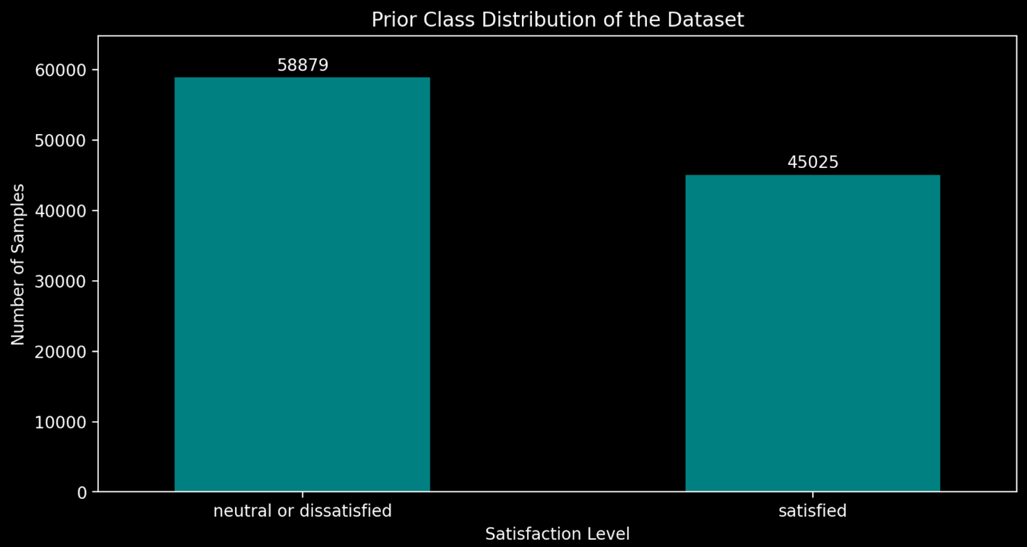
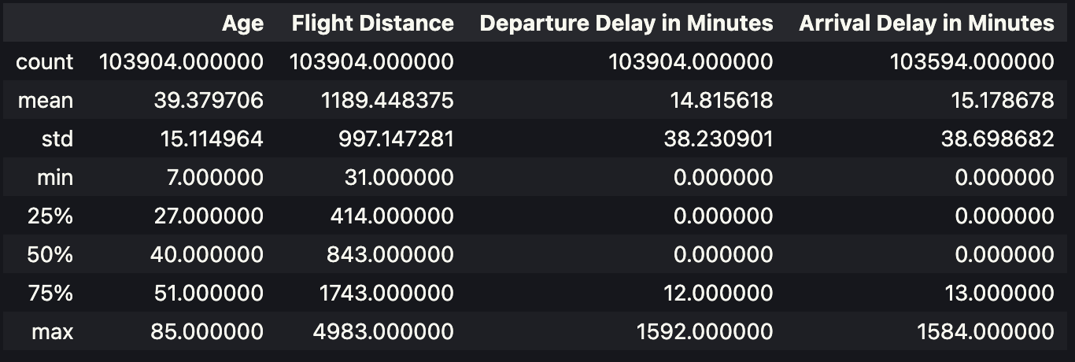
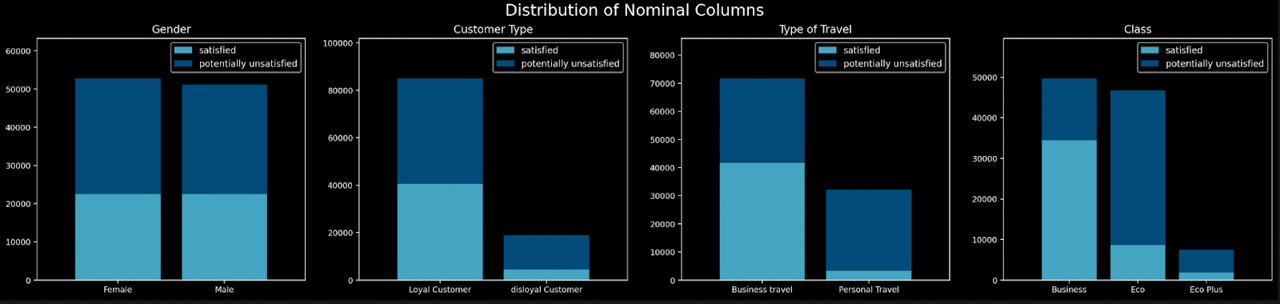
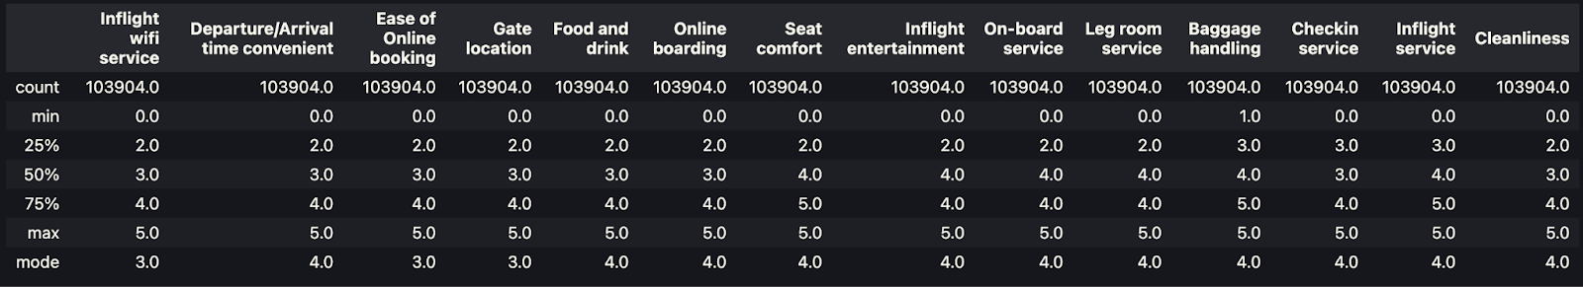
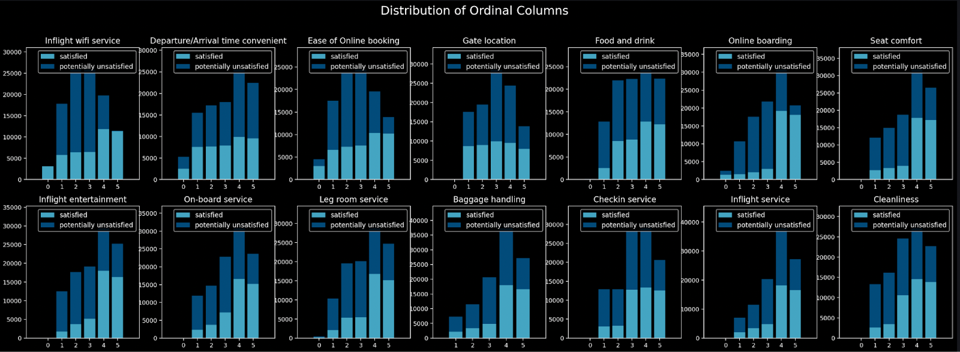
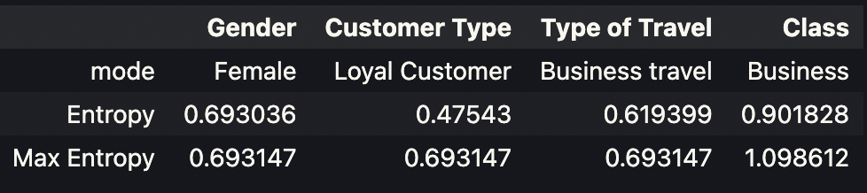
EDA: Univariate Analysis
I. Mean, Median, Mode, STD, Quartiles of Numerical Variables
II. Mode, Median, IQR & Entropy of Ordinal Variables
III. Mode, Entropy & Max Entropy of Nominal Variables
More plots and insights in report…

Slide 8
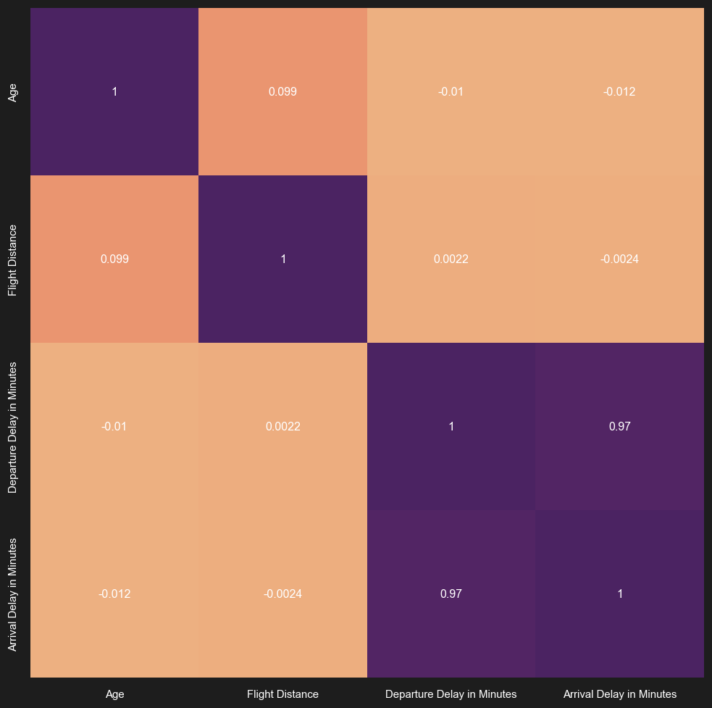
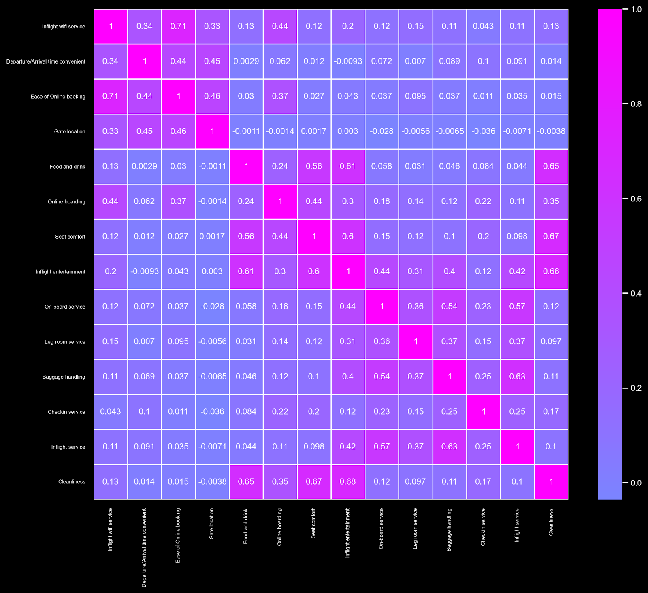
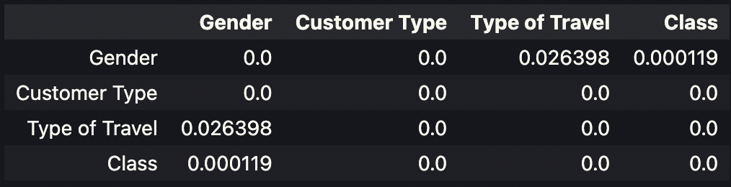
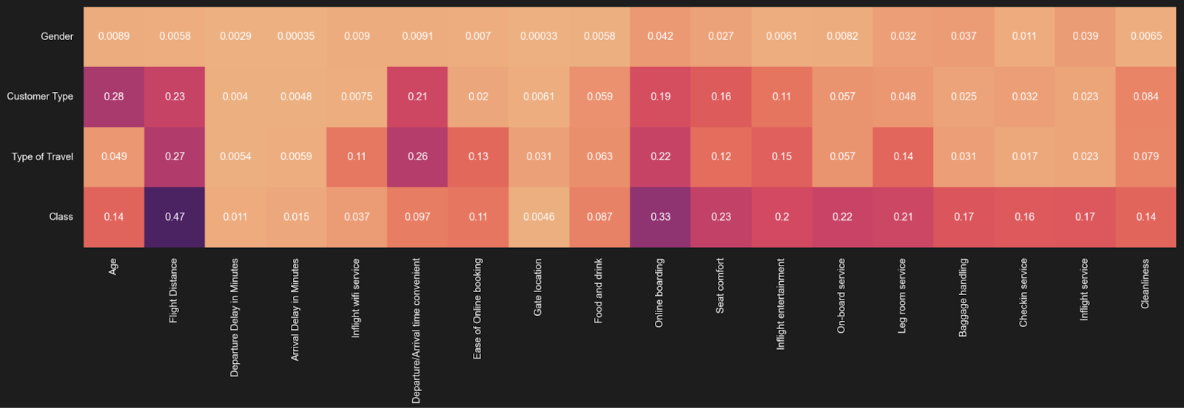
EDA: Correlations & Associations
Categorical & Categorical
Numerical & Numerical
Ordinal & Ordinal
$H_{O}$: The two categorical variables are independent.
$H_{1}$: The two categorical variables are dependent.
Numerical & Categorical
Check NB Test in Report…

Slide 9
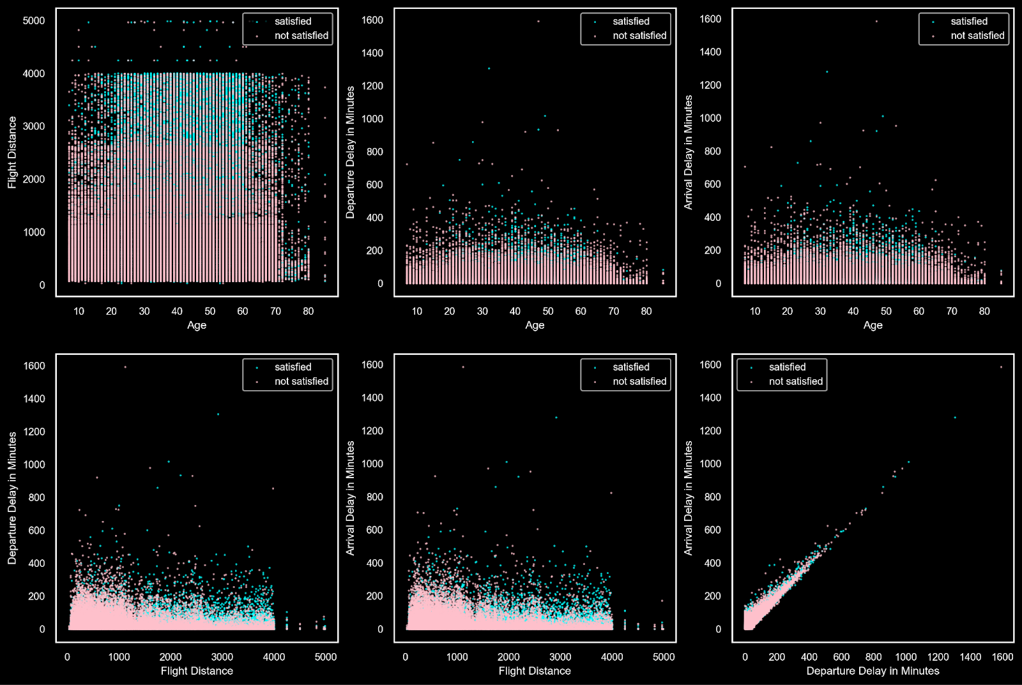
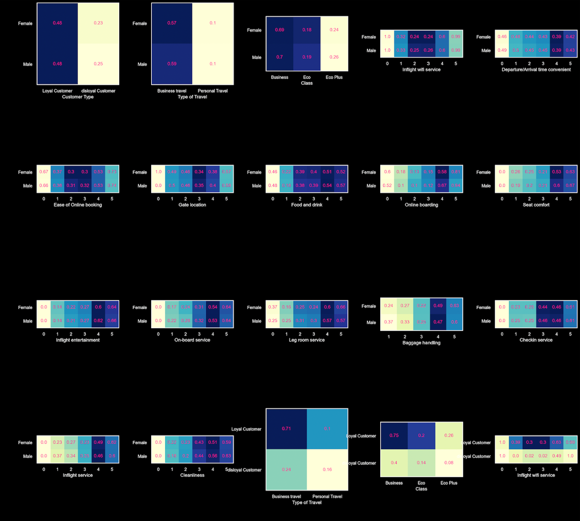
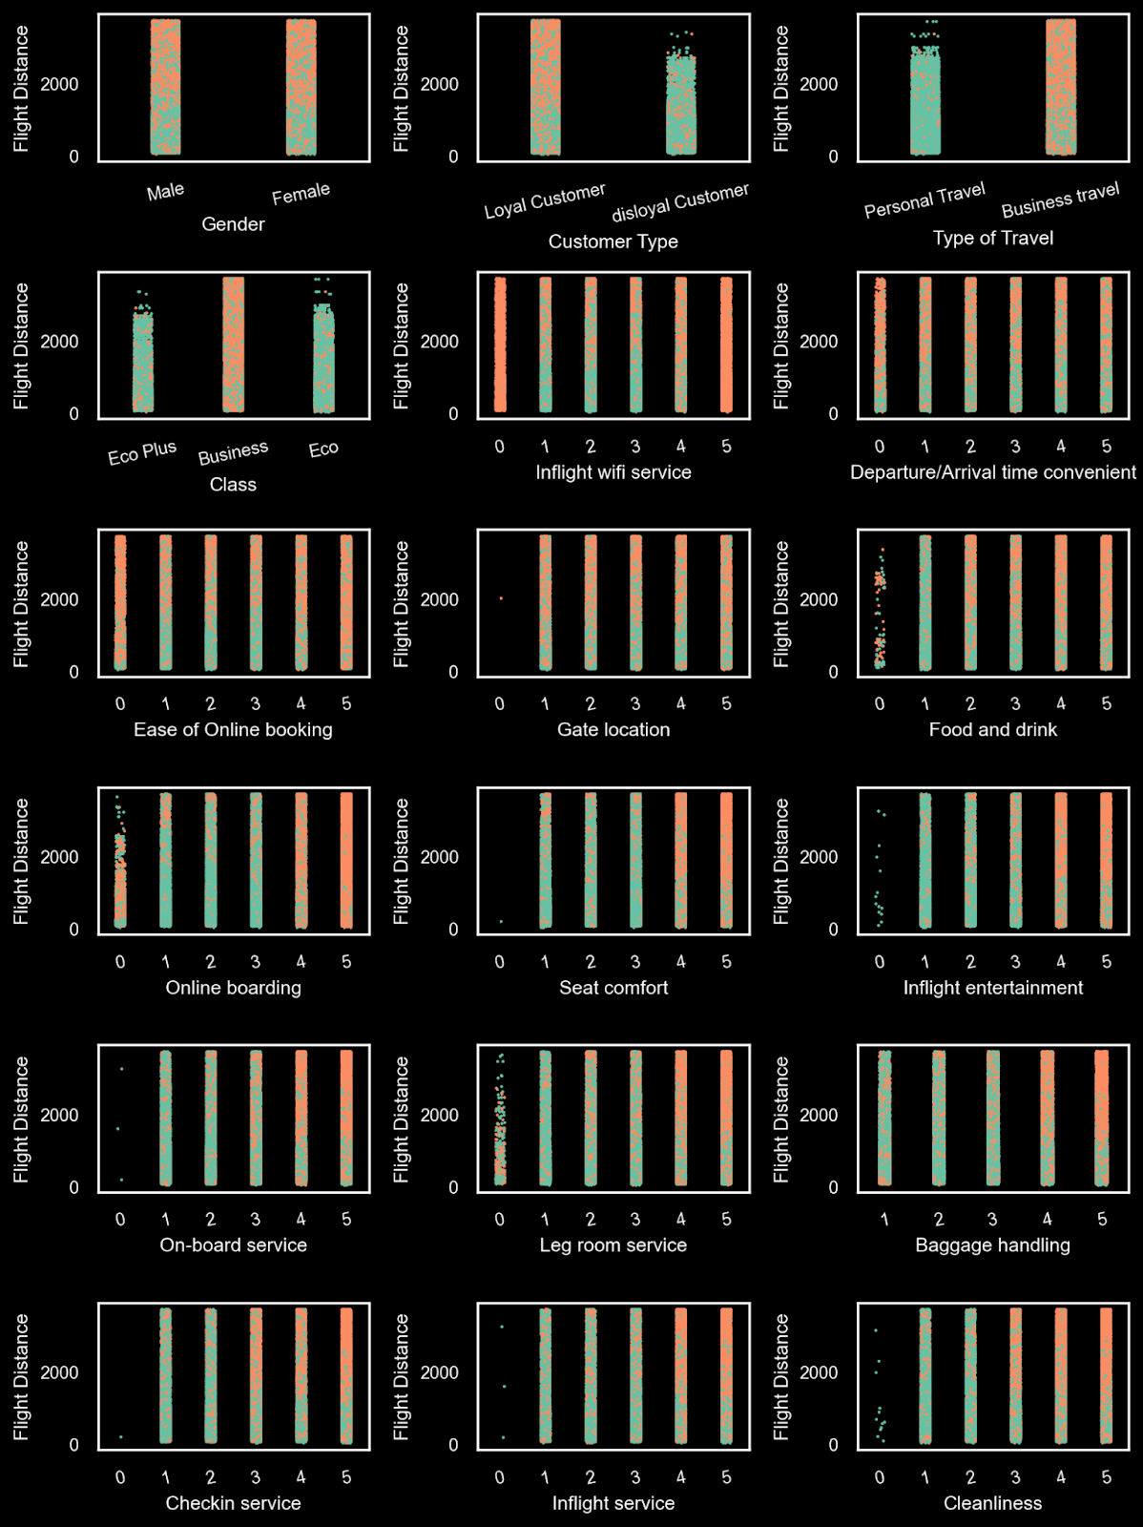
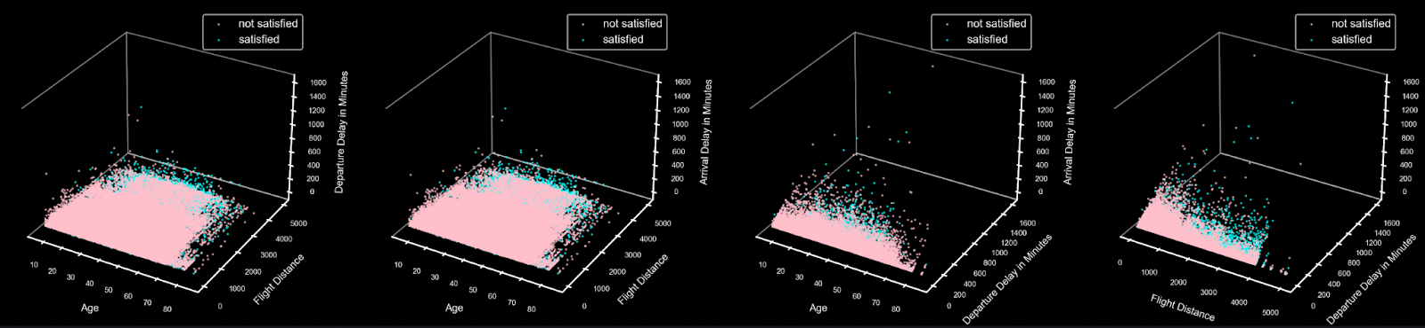
EDA: Multivariate Analysis
Categorical & Categorical
Numerical & Numerical
Numerical & Categorical

Slide 10
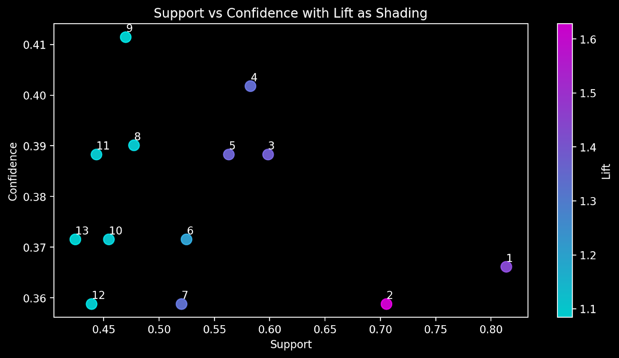
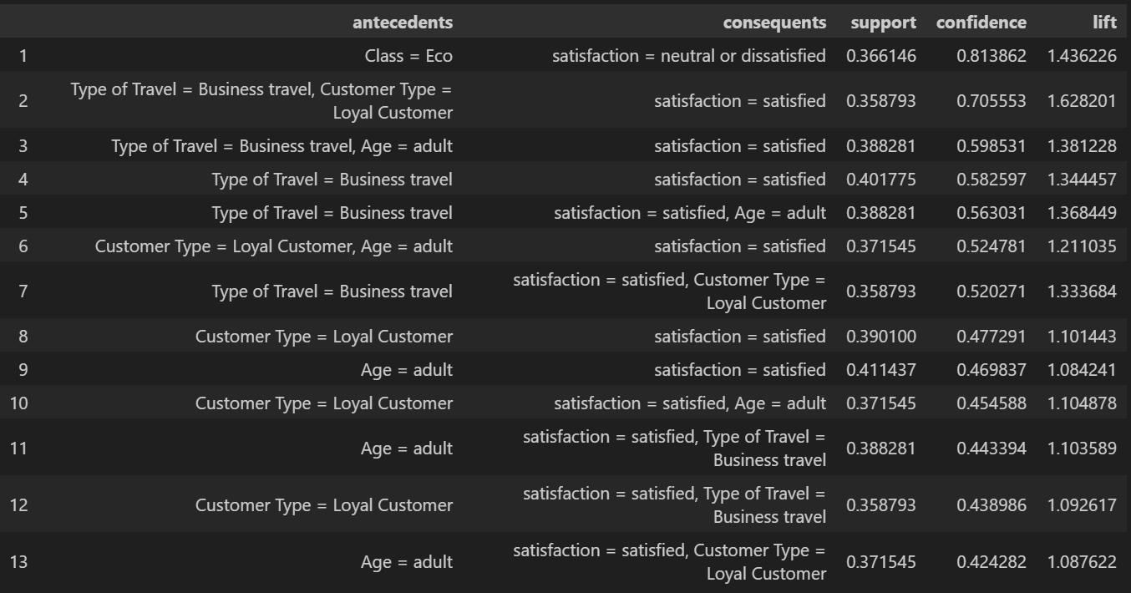

Apriori Model
One-hot encoding of the categorical features
$MinSupp=0.35$, $Lift≥1$ yielded a moderate set of rules

Slide 11
SVM Model
Two experiments, one with standardized features and another with grid search
Results were as follows
Model | Training Accuracy | Validation Accuracy
Experiment I | 87.4% | 87.13%
Experiment II | 87.8% | 87.3%

Slide 12
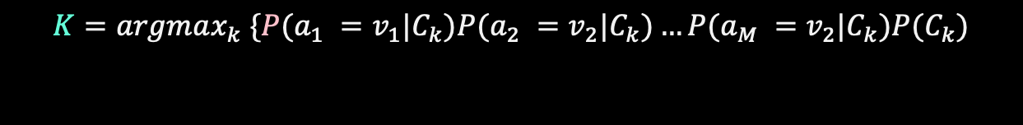
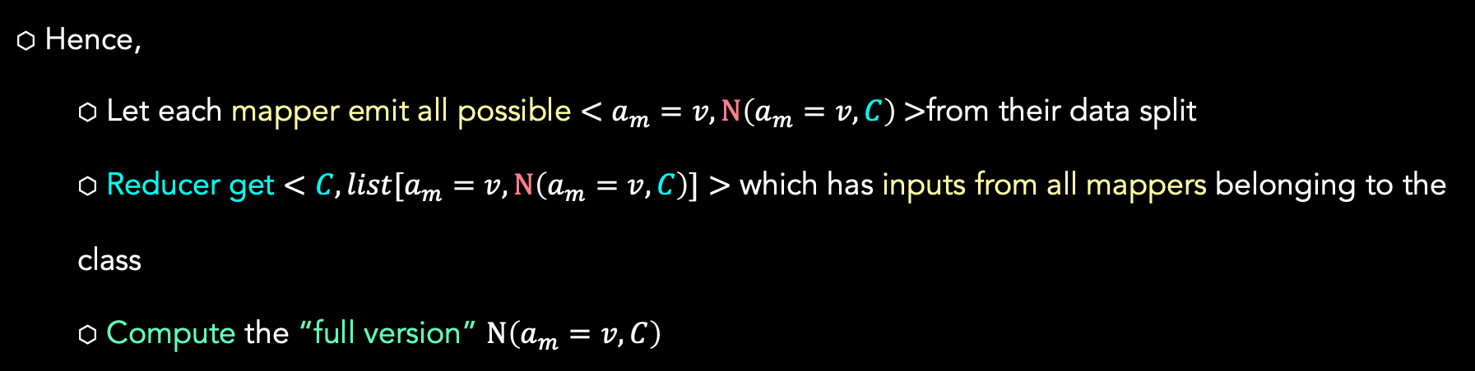
Naïve Bayes Model
Implemented from scratch using MapReduce
$$K=argmax_{k} \{P(a_{1} =v_{1}|C_{k})P(a_{2} =v_{2}|C_{k})…P(a_{M} =v_{2}|C_{k})P(C_{k})$$
Hence,
Let each mapper emit all possible $<a_{m}=v,N\left(a_{m}=v, C\right)\text{ >}\text{from} \text{their} \text{data} \text{split}$
Reducer get $<C, list[a_{m}=v,N\left(a_{m}=v, C\right)]>$ which has inputs from all mappers belonging to the class
Compute the “full version” $N\left(a_{m}=v, C\right)$
Model | Training Accuracy | Validation Accuracy
Multinomial Naive Bayes | 89.4% | 89.1%

Slide 13
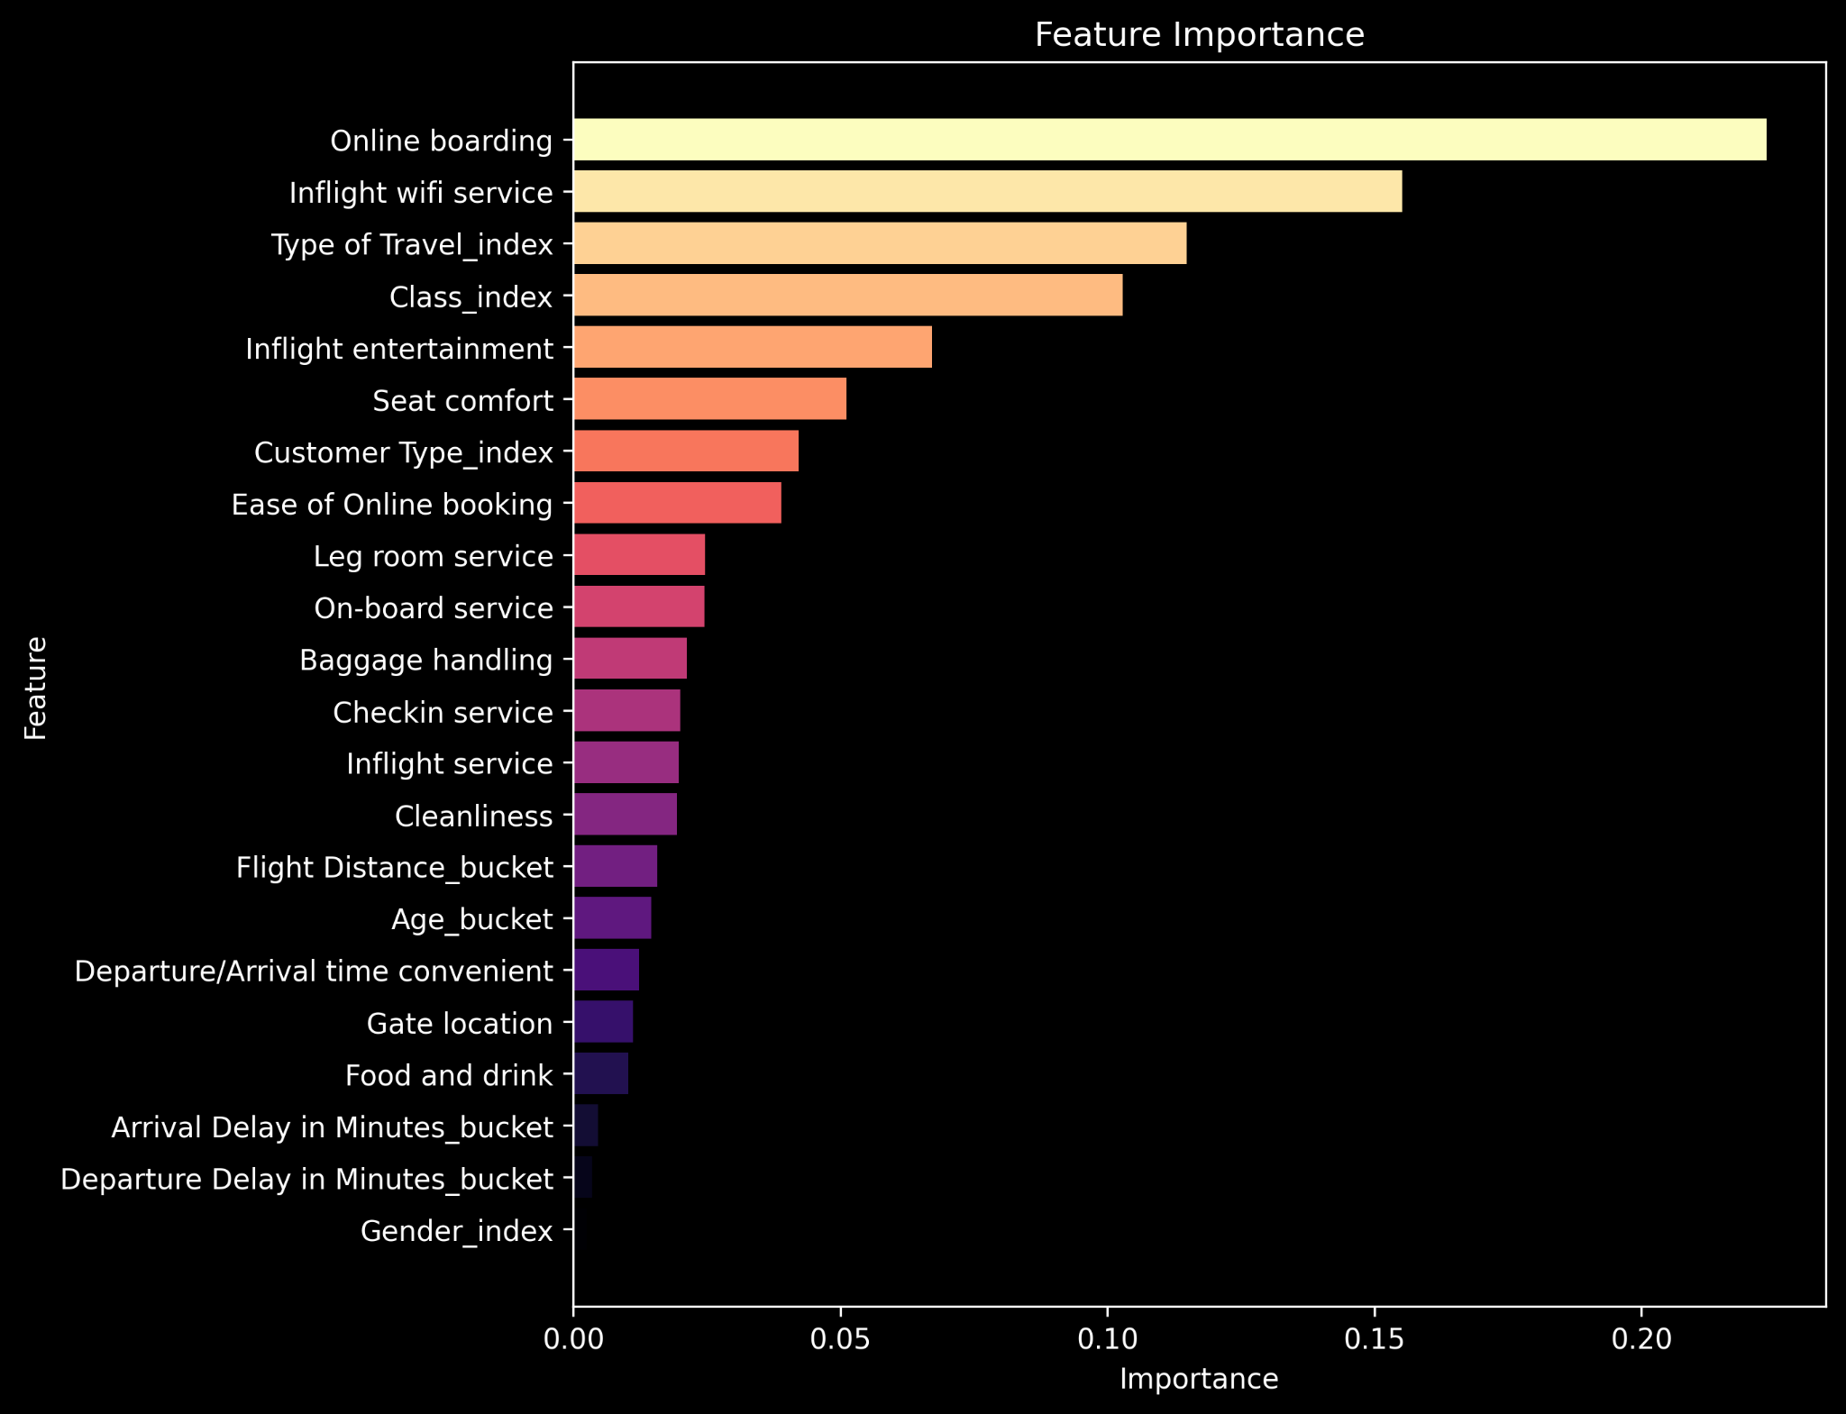

Random Forest Model
Classic data preparation with bucketizer
Initially got $92\%$
Tuned the max_depth and split_strategy to get $96\%$
Considered feature importance
Model | Training Accuracy | Validation Accuracy
Random Forest | 97.4% | 96%

Slide 14

Business Takeaways
There is a lack of satisfaction in airline travel experience (imbalance)
Such lack is focused on economy travelers
Wi-Fi Service, Entertainment and Online Boarding are key determinants.
Comfort and ease of booking also matter
Distance and delays seem to have a less adverse effect

Slide 15
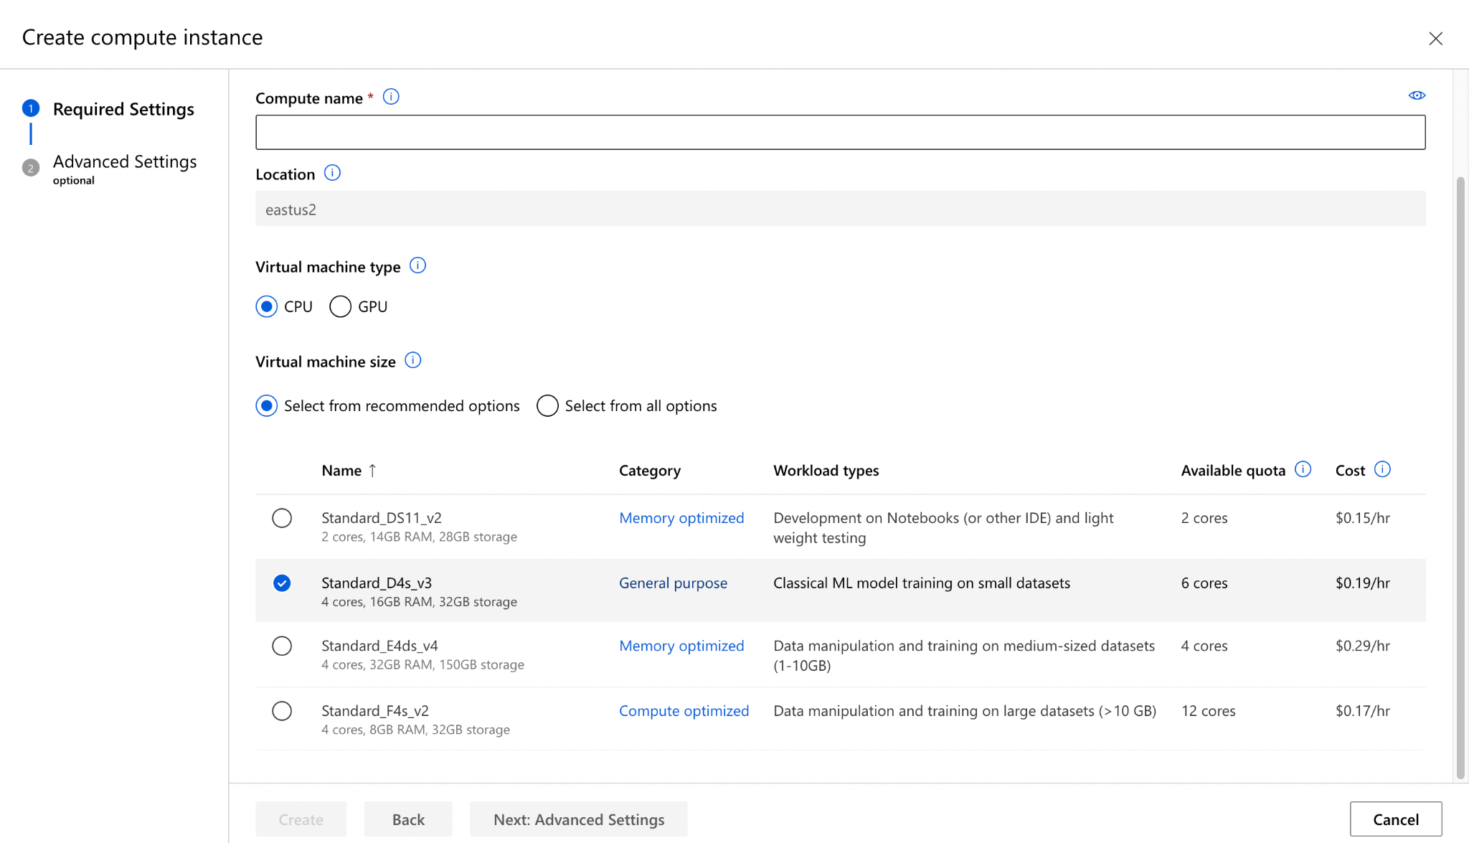
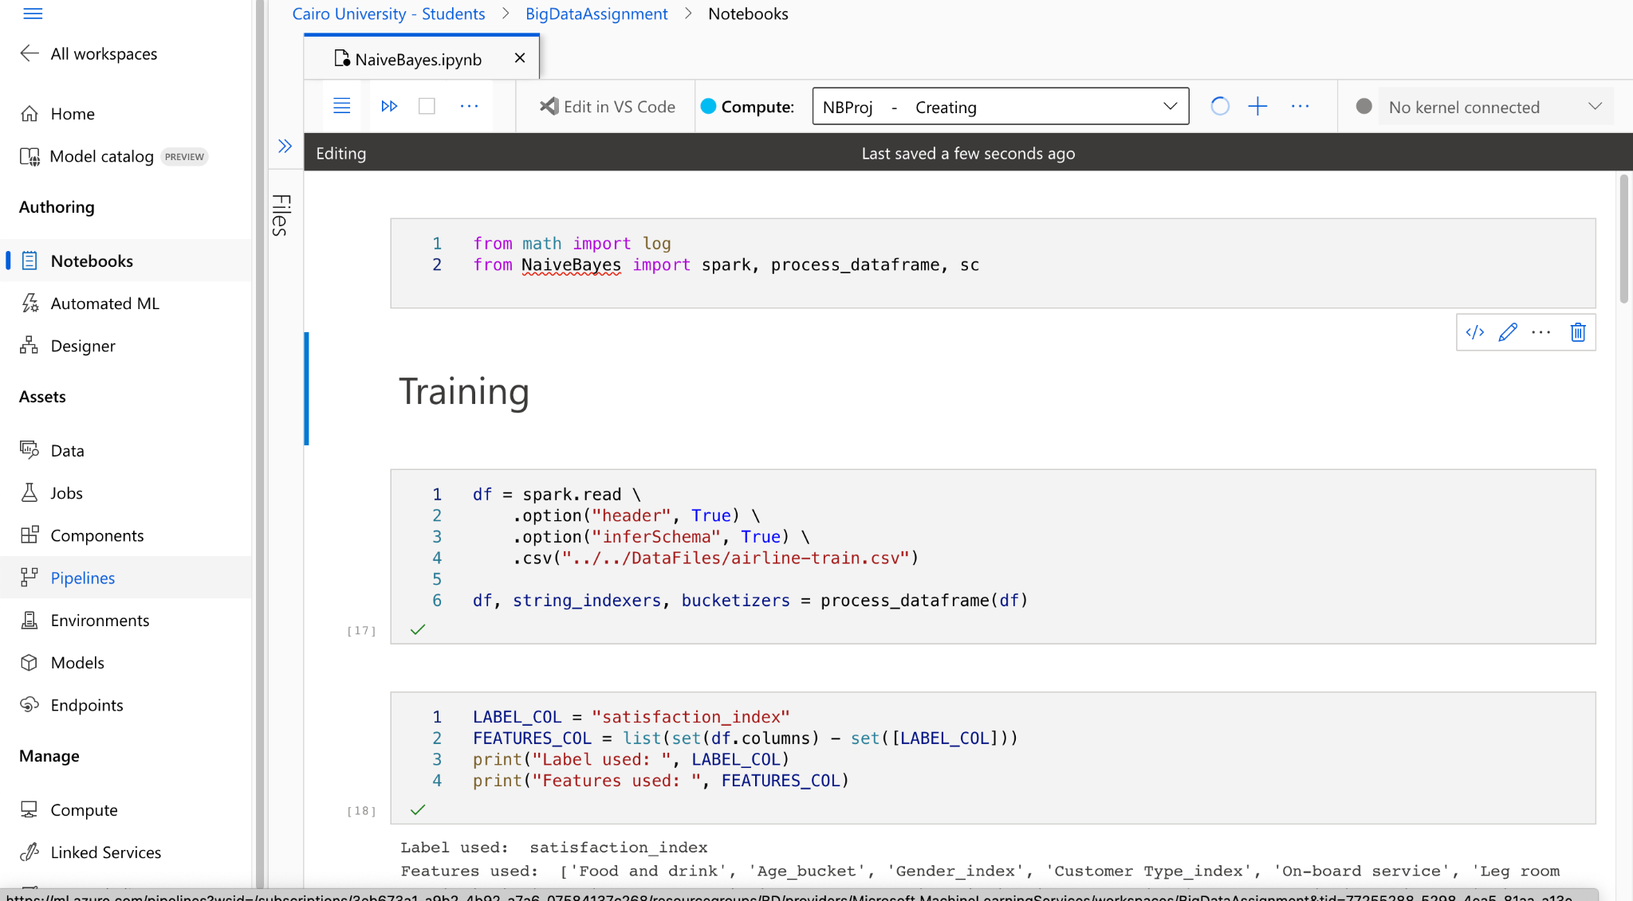
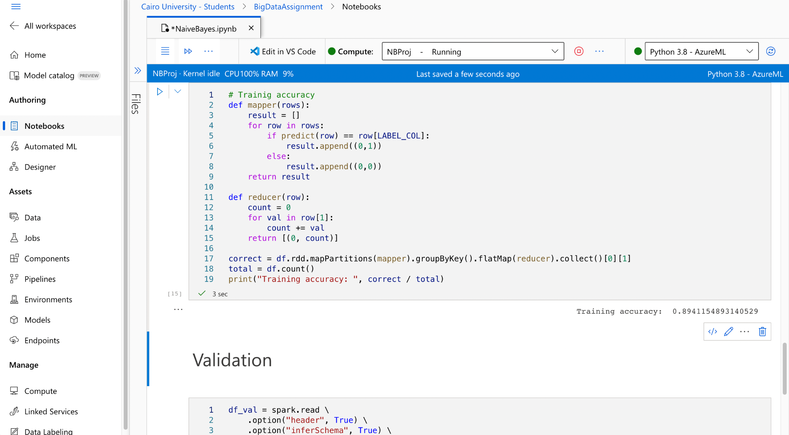
Running on the Cloud

Slide 16
Thank You.

